Slide 1
London Crime
Data Exploration
Maddalena Amendola
Giuliano Cornacchia
Mario Leonardo Salinas
Pisa, 26/10/2018
University of Pisa

Slide 2
Outline
Dataset description
Distribution Analysis
Geolocalized Distribution Analysis
Correlation
Analytical Project Proposals

Slide 3
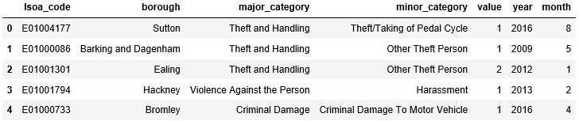
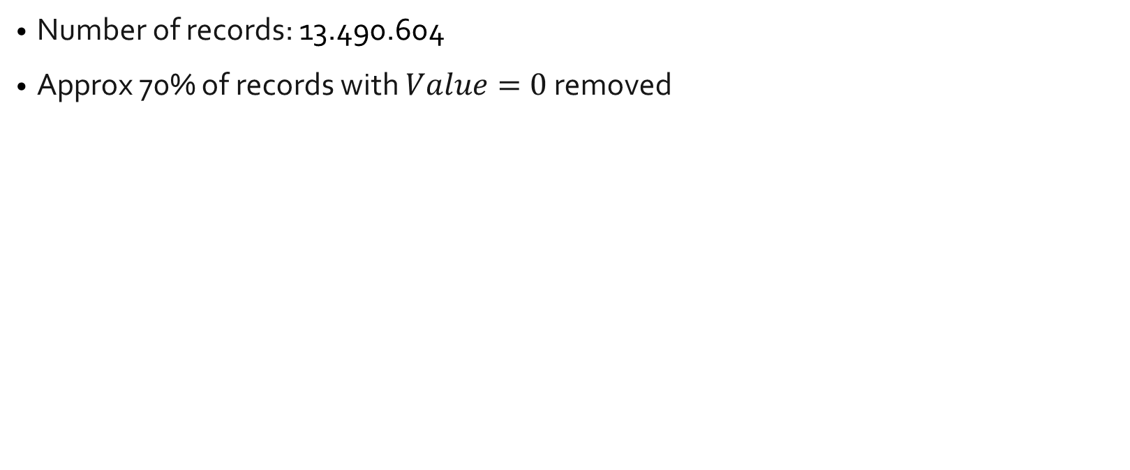
Dataset Description
Number of records: 13.490.604
Approx 70% of records with $Value=0$ removed

Slide 4
Outline
Dataset Desciption
Distribution Analysis
Geolocalized Distribution Analysis
Correlation
Analytical Project Proposals

Slide 5
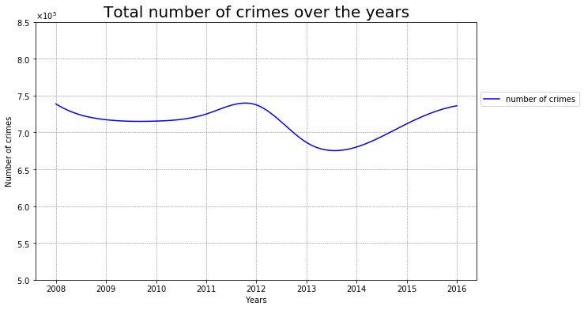
Distribution Analysis
The number of crimes is equally distributed between the years except for small fluctuations of 0.1%

Slide 6
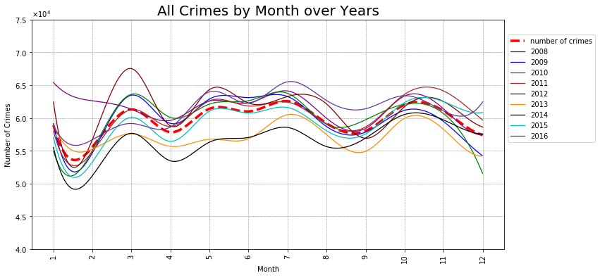
Distribution Analysis
The total number of crimes varies each month compared to its average at most by 5k / 10k.

Slide 7
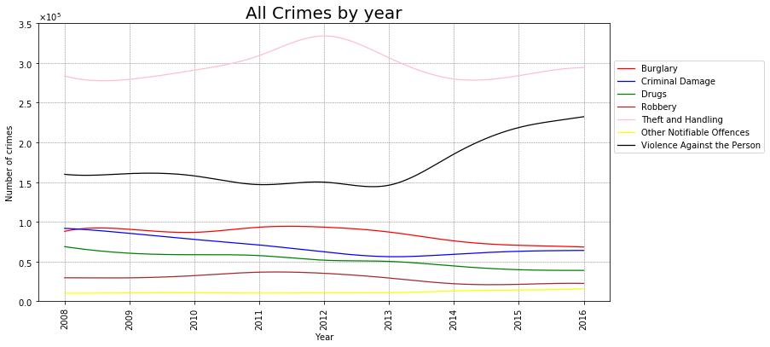
Distribution Analysis
The fraction of felony with a specific category over the total number of crimes is constant in time.

Slide 8
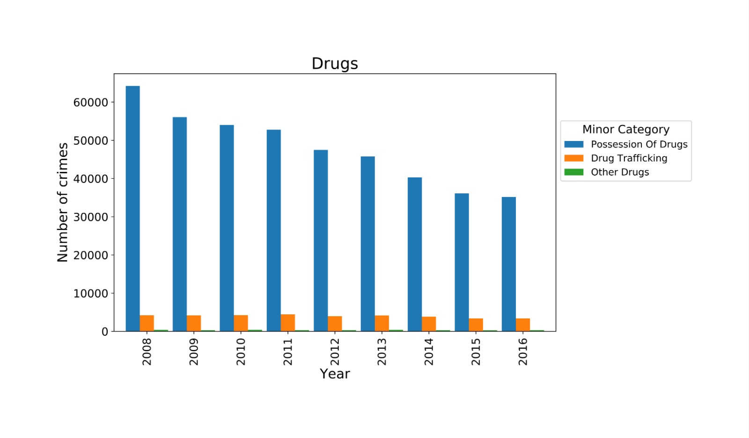
Distribution Analysis

Slide 9
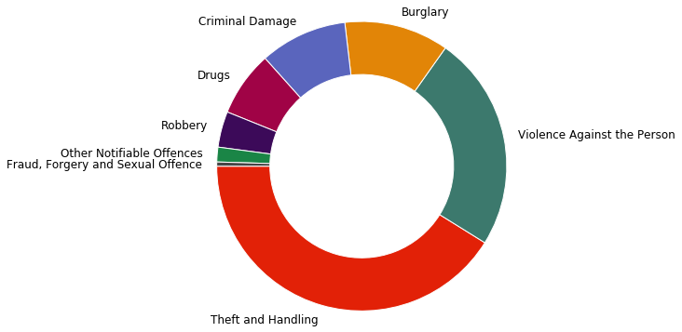
Distribution Analysis

Slide 10
Outline
Dataset Description
Distribution Analysis
Geolocalized Distribution Analysis
Correlation
Analytical Project Proposals

Slide 11
Geolocalized distribution analysis: Motivations
we're dealing with geographic entities such as LSOAs and boroughs.
the dataset must be extended with geographical attributes: the shapes of boroughs and LSOA.

Slide 12
Geolocalized distribution analysis: Approach
time-series-like approach, we split the geo-dataset by year.
to better understand the trends highlighted in the exploratory analysis section, we choose to reproduce the same plots in this geolocalized analysis.
The quantitative information visualized is crime/month value.

Slide 13
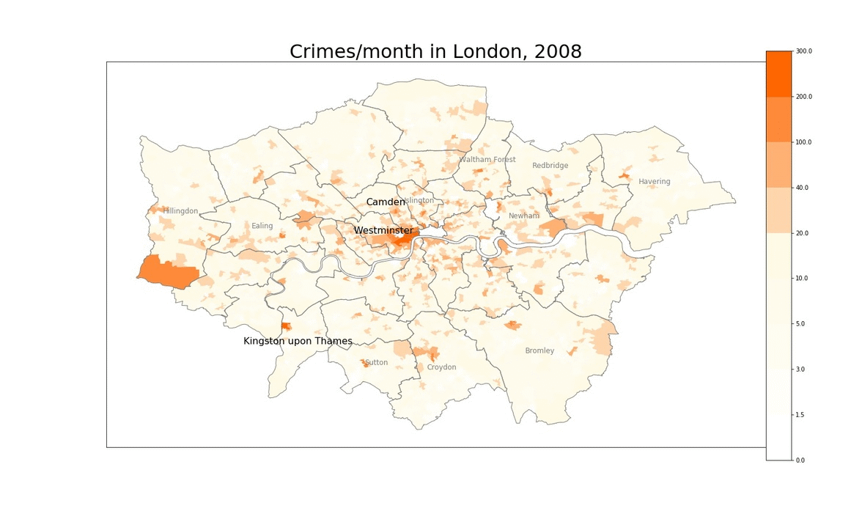
Geolocalized distribution analysis
hotspots inside dangerous boroughs are usually isolated
Westminister and, in general the LSOAs above the Thames tend to be the most dangeorus zones

Slide 14
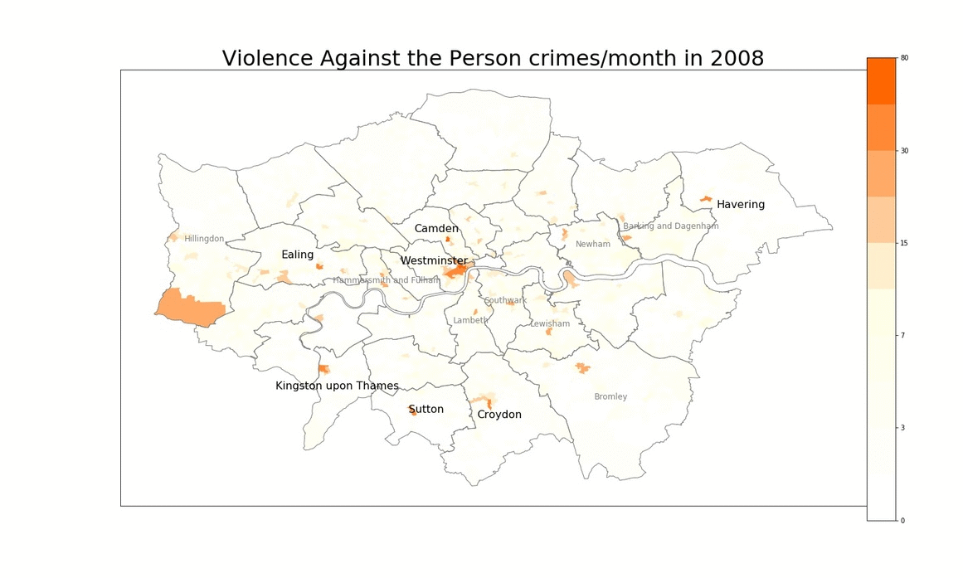
Geolocalized distribution analysis
crimes are denser and higher in number in the northern bank of the Thames also in this case and hotspots behaves in the same way.

Slide 15
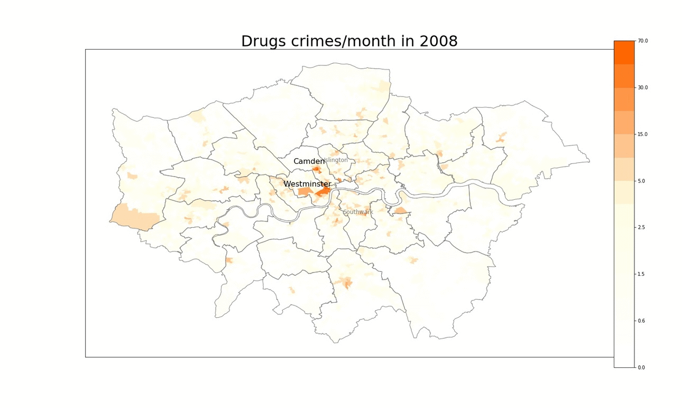
Geolocalized distribution analysis

Slide 16
Outline
Dataset Description
Distribution Analysis
Geolocalized Distribution Analysis
Correlation
Analytical Project Proposals

Slide 17
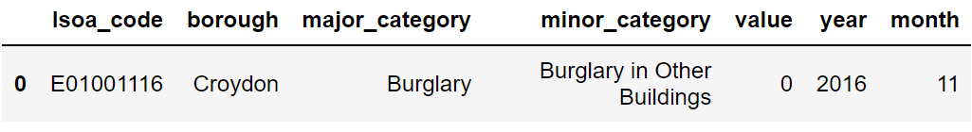
Correlation
Numerical attribute
Only «value» is significant

Slide 18
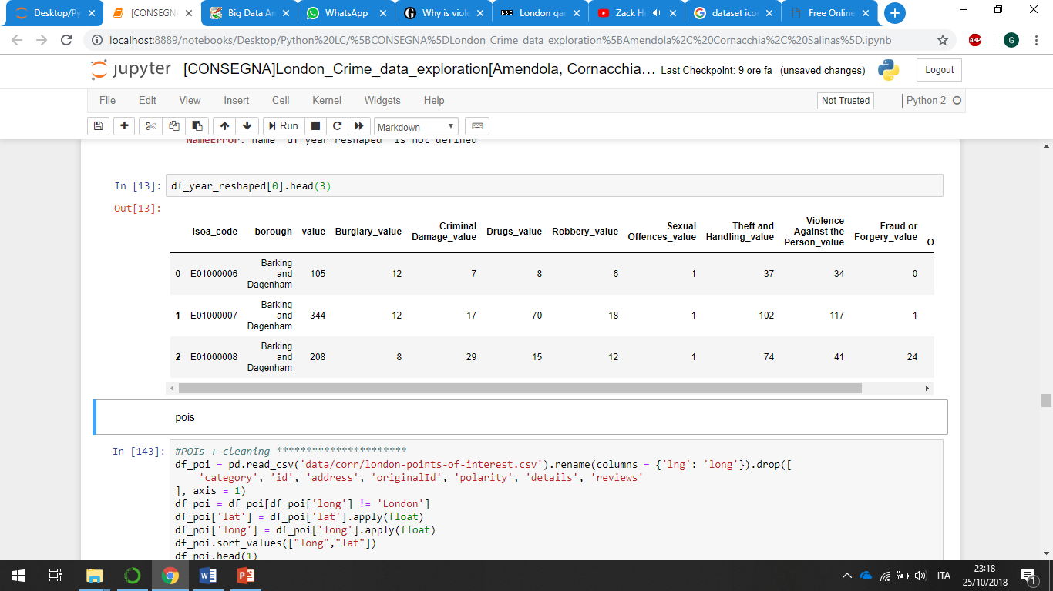
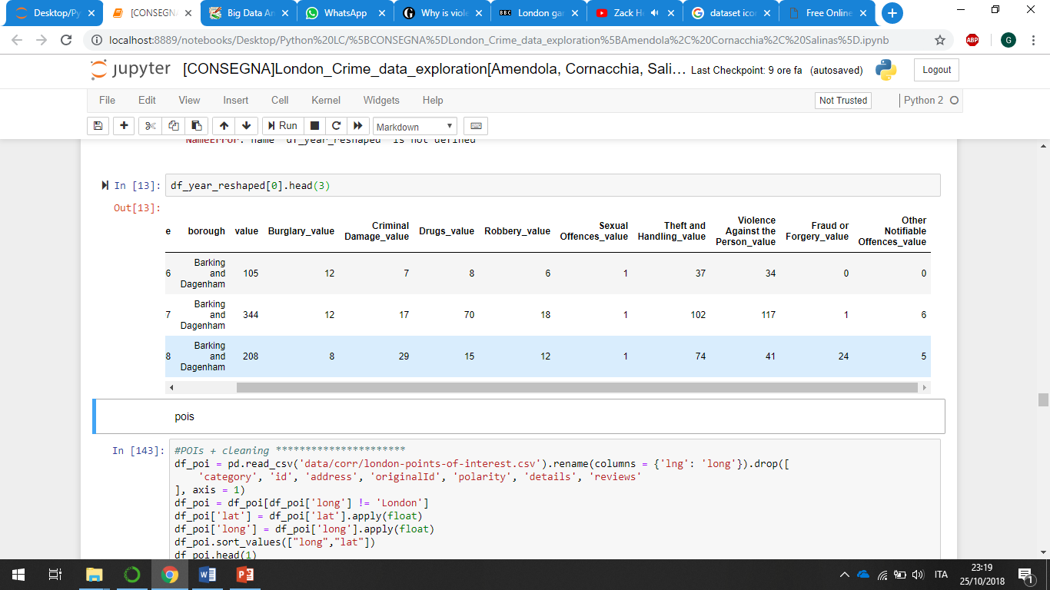

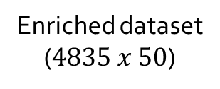
Correlation
We create a new dataset for each year with one row for LSOA and a new attribute for major Crime.
Sum of all «Theft and Handling» crimes occured
in the row-relative LSOA
base
demographics
Merge
economics
Enriched dataset ($4835 x 50$)
points of interest

Slide 19
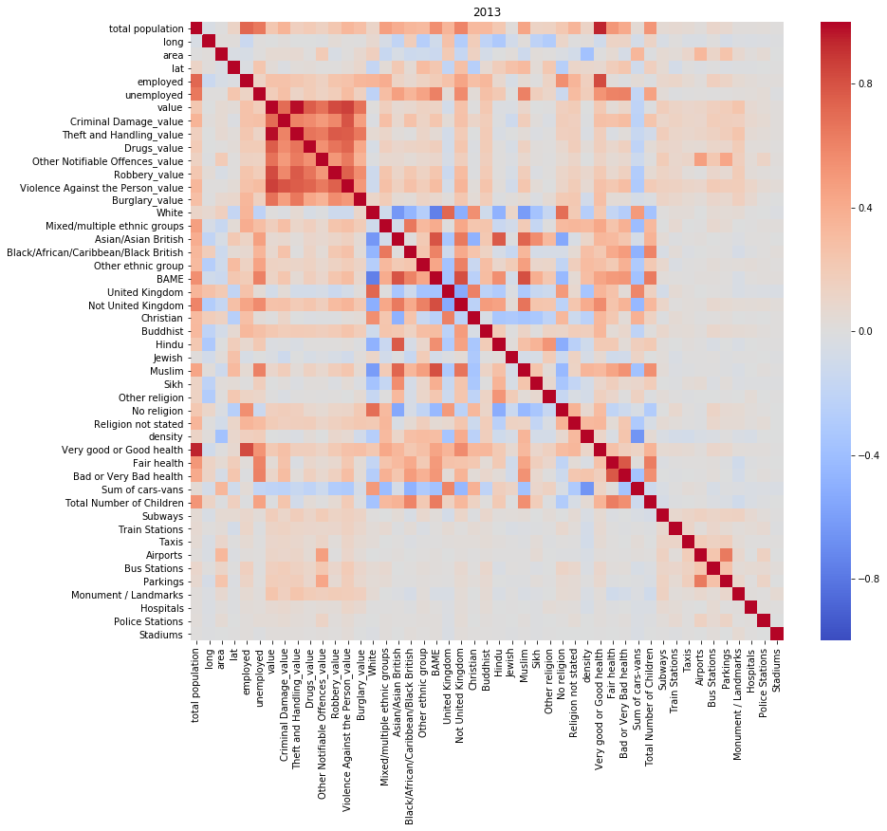
Correlation
LSOA level (enriched dataset)

Slide 20
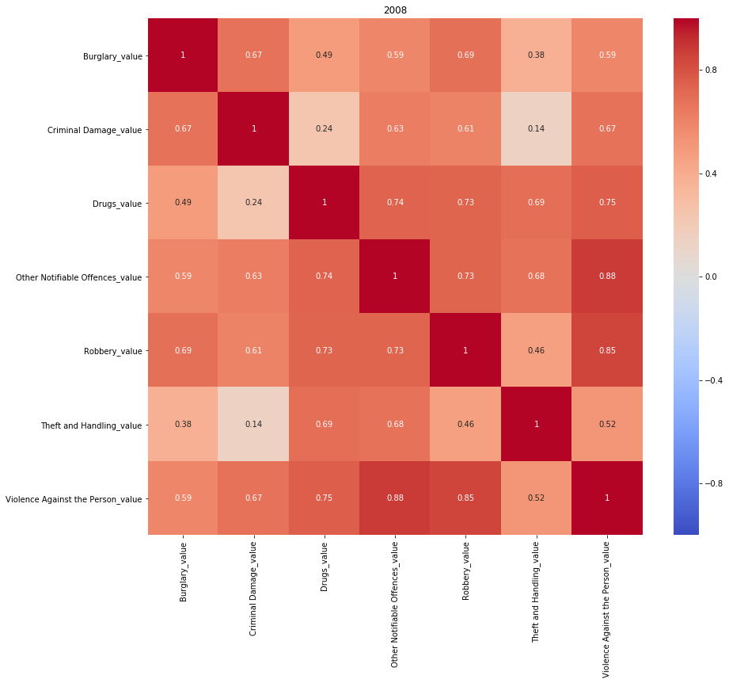
Correlation
LSOA level (enriched dataset)

Slide 21
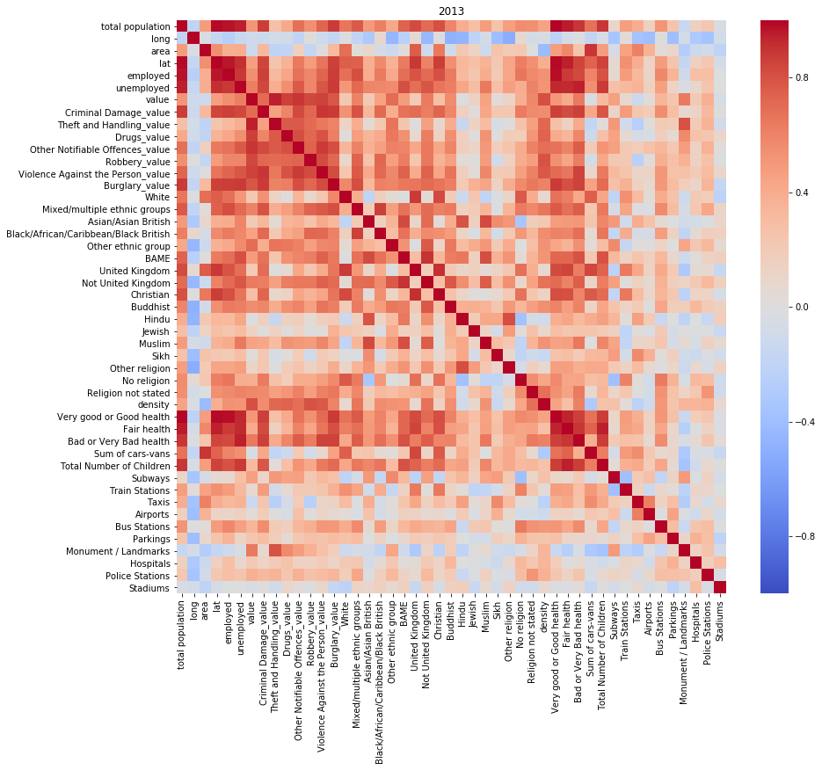
Correlation
BOROUGH level (enriched dataset)
Theft and Handling / Monuments
Violence / Not UK
Criminal Damage / Christian

Slide 22
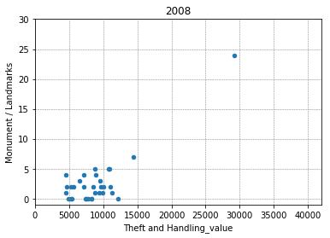
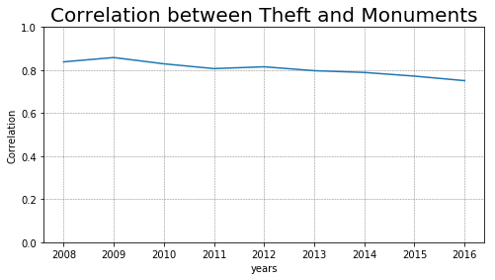
Correlation
Theft and Handling / Monuments

Slide 23
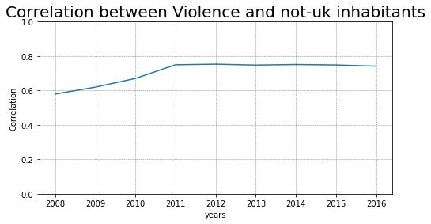
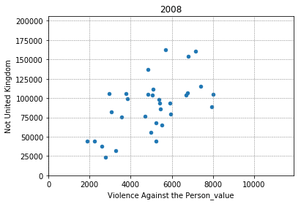
Correlation
Violence / not UK

Slide 24
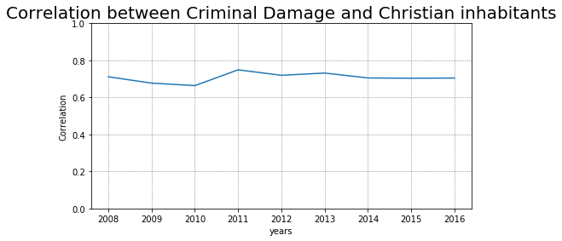
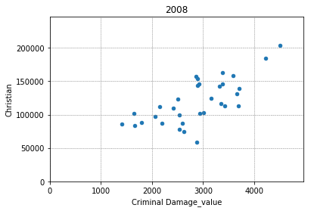
Correlation
Criminal Damage / Christian

Slide 25
Panoramica
Dataset Description
Distribution Analysis
Geolocalized Distribution Analysis
Correlation
Analytical Project Proposal

Slide 26
Analytical Project Proposal
Model that predicts the number and the kind of crimes that will occour in a specific LSOA given the month and year.
Model that predicts the number and the kind of crimes that will occour in a specific BOROUGH given the month and year.
Given the avaliable resources of London Police provide a «smart» way to arrange them in order to reduce the number of crimes according to the prediction of our model.

